Slide 1

Making a Chatbot with Rasa NLU

Slide 2
Prerequisites
Install anaconda 3
(optional) create a virtual environment
conda create –n chatbot python=3
Install the rest of the modules
pip install rasa_nlu
pip install rasa_core
conda install -c conda-forge spacy
python –m spacy download en

Slide 3
To Install the Trainer UI
For the trainer UI you need node
(Linux)
curl -sL https://deb.nodesource.com/setup_8.x | sudo -E bash -
sudo apt-get install -y nodejs build-essential
(Mac)
brew install node
(Windows)
Download installer from https://nodejs.org/en/#download
To install the trainer
npm i –g rasa-nlu-trainer

Slide 4
Using the Trainer UI
Go to the following url:
https://rasahq.github.io/rasa-nlu-trainer/
Here you can edit the training examples, then download the files when done

Slide 5
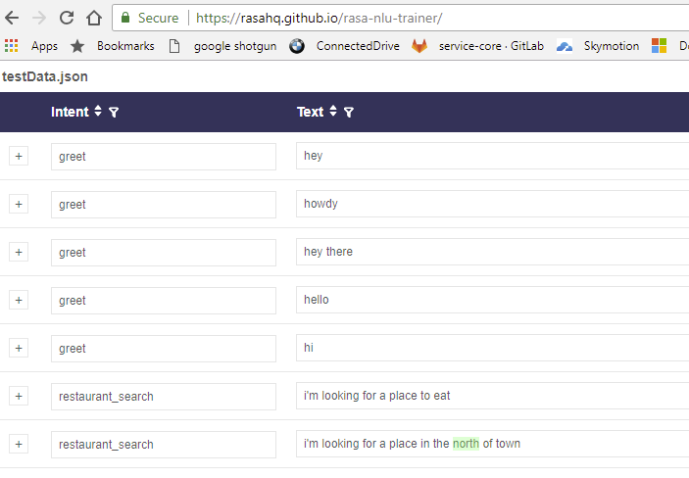
The Training UI

Slide 6
Training with Rasa NLU
Click on the Download link to download the testData.json file
Move or copy the file to your work folder
Create a file named config_spacy.json and add the following lines
{
"language": "en",
“pipeline”: “spacy_sklearn“
}
Now we can train the model
python –m rasa_nlu.train \
--config config_spacy.json \
--data testData.json \
--path projects

Slide 7
Testing our Rasa NLU Model
Run the Rasa NLU server
python -m rasa_nlu.server --path projects
Then in another shell
curl -X POST localhost:5000/parse -d '{"q":"I am looking for Mexican food"}' | python -m json.tool
For status
curl 'http://localhost:5000/status’

Slide 8
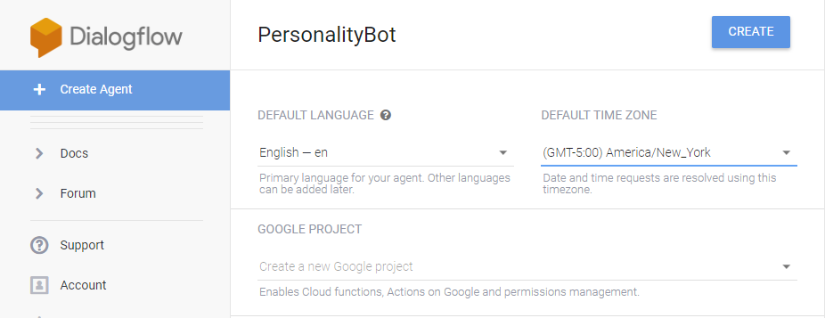
To Give our Chatbot some Personality
Create a Dialogflow account and sign in with Google
On the left side, click on Create Agent, enter a name for the agent and click on the CREATE button

Slide 9
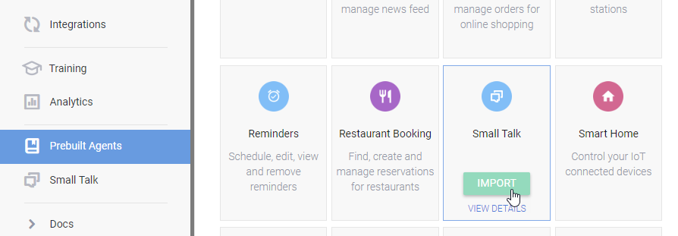
To add Conversation
Click on Prebuilt Agents, then select the Small Talk agent and click on the IMPORT button

Slide 10
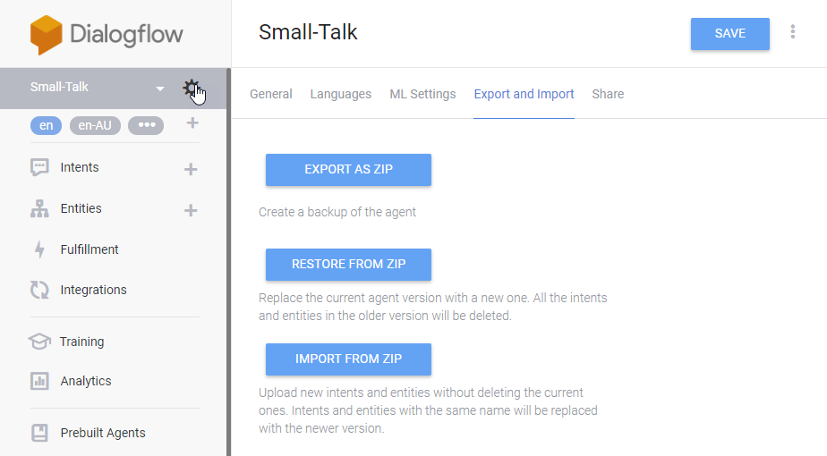
Export the Intents and Entities
Click on the Settings wheel button to the right of the Small-Talk agent then click on the Export and Import tab and click on EXPORT AS ZIP button

Slide 11
Using the Exported Intents and Entities
Copy the Small-Talk.zip file to your work folder and unzip it to the Small-Talk folder
Train it
python -m rasa_nlu.train --config config_spacy.json --data Small-Talk --path projects
Test it
curl -X POST localhost:5000/parse -d '{"q":"how are you buddy?"}' | python -m json.tool

